Slide 1

FAKE NEWS DETECTION
A PRESENTATION ON
ML PROJECT
Presented by:
A Anto Nigin (142202001)
Aditya Dandriyal (142202003)
Abhinav Raj (142202026)

Slide 2
Objectives:
We consume news through several mediums throughout the day. Since all the news we encounter in our day-to-day life is not authentic, hence the need to identify the fake ones.
Through this project we aim to accurately classify news as real or fake.
The dataset we are using contains 20800 rows and 5 columns – id, title, author, text and label(1 for fake, 0 for real).
Primarily we will be making use of Natural Language Processing(NLP) techiniques in order to work with our text data.

Slide 3
Data Preprocessing:
Dealing with missing values:
We checked for missing values in each columns of the dataset.
Then we replaced the null values with empty string.
For further data processing we decided to focus on title and author columns of the dataset . So we merged them to form a single column- content.
We modified this content column to extract more information and thus improve the performance of the ML models, by making use functionalities of ‘nltk’ library , namely stopwords removal, stemming and lemmatization.

Slide 4
Vectorization & Feature Selection:
Vectorization is a classic approach of converting input data from its raw format (i.e. text ) into vectors of real numbers which is the format that ML models support.
Vectorization techniques used in this project are:
Bag of Words: In this method a sparse matrix is created for the input, out of the frequency of vocabulary words. In this sparse matrix, each row is a sentence vector whose length (the columns of the matrix) is equal to the size of the vocabulary.
TF-IDF: In this method a sparse matrix is created for the input, out of the tf-idf values of vocabulary words. In this sparse matrix each row is a document and each column represents words in a corpus
Word2Vec: this approach uses the power of a simple Neural Network to generate word embeddings. Each word is represented as a 100 dimensional vector and words having similar meaning exist in close proximity to each other in the 100 dimensional hyperspace. Each document is represented as a vector by taking the mean of all the words in the document in vector format.
Feature selection done on bag of words and tfidf methods using Chi2.

Slide 5
Modelling:
After vectorization and feature selection we considered permutations of the afore mentioned methods(vectorization & feature selection) and established five cases to work upon.
For each of the cases we used six ML classification models – Logistic Regression, Decision Tree, Random Forest, Multinomial Naïve Bayes, K-Nearest-Neighbour and SVC.
Then we used K-fold cross validation to get the accuracy of the models for each case.
Based on the above accuracy score we considered the top two models and using the 5x2 cv paired t test we compared the performance of these two models.
As per the result of the above test we established best model(s) for each of the considered cases.

Slide 6
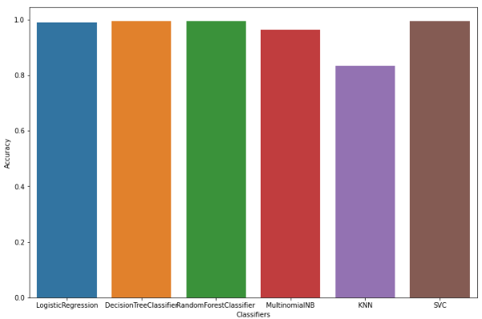
Results:
Bag of Words:
CLASSIFIERS | ACCURACY
Logistic Regression | 0.990577
Decision Tree Classifier | 0.995385
Random Forest Classifier | 0.993894
Multinomial Naïve Bayes | 0.963558
KNN (n=3) | 0.834615
SVC (linear kernel) | 0.994904
The input is a sparse matrix of size 20800x17128 (17128 words in corpus and 20800 documents).
The top 2 models in terms of accuracy are Decision Tree and SVC.
Further from 5x2 cv paired t test we get that, (p-value = 0.637)
since we cannot reject the null hypothesis, thus we can conclude that the performance of the
two models is probably same.

Slide 7
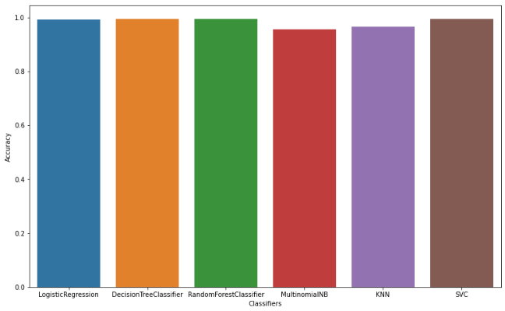
Bag of Words + Chi Square Test for feature selection:
CLASSIFIERS | ACCURACY
Logistic Regression | 0.99153
Decision Tree Classifier | 0.993702
Random Forest Classifier | 0.994087
Multinomial Naïve Bayes | 0.955529
KNN (n=3) | 0.965385
SVC (linear kernel) | 0.995000
Using chi square test the number of features were reduced from 17128 to 3036. Thus the final input sparse matrix is of size 20800x3036.
The top 2 models in terms of accuracy are Random Forest and SVC.
Further from 5x2 cv paired t test we get that, (p-value = 0.00563)
since we can reject the null hypothesis that both models perform equally well on this dataset.
Thus we may conclude that the two models are significantly different.
Hence we take SVC classifier as the most accurate one.

Slide 8
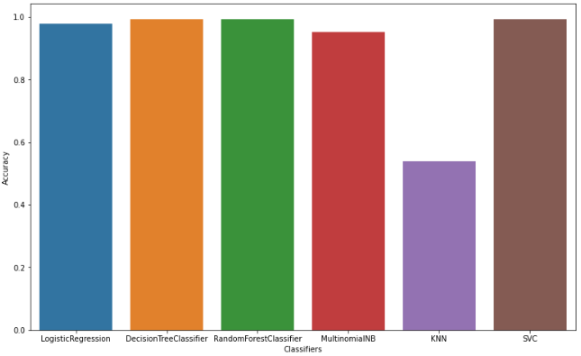
TF-IDF :
CLASSIFIERS | ACCURACY
Logistic Regression | 0.978269
Decision Tree Classifier | 0.993654
Random Forest Classifier | 0.993750
Multinomial Naïve Bayes | 0.952163
KNN (n=3) | 0.539712
SVC (linear kernel) | 0.992308
The input is a sparse matrix of size 20800x17128.
The top 2 models in terms of accuracy are Random Forest and Decision Tree Classifier.
Further from 5x2 cv paired t test we get that, (p-value = 0.0728)
since we cannot reject the null hypothesis, thus we can conclude that the performance of the
two models is probably same.

Slide 9
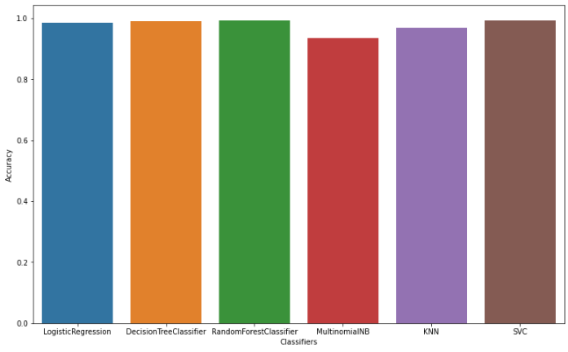
TF-IDF + Chi Square Test for feature selection:
CLASSIFIERS | ACCURACY
Logistic Regression | 0.985913
Decision Tree Classifier | 0.990865
Random Forest Classifier | 0.993365
Multinomial Naïve Bayes | 0.934375
KNN (n=3) | 0.968798
SVC (rbf kernel) | 0.992885
Using chi square test the number of features were reduced from 17128 to 1063.Thus the final input sparse matrix is of size 20800x1063.
The top 2 models in terms of accuracy are Random Forest and SVC.
Further from 5x2 cv paired t test we get that, (p-value = 0.0286 )
since we can reject the null hypothesis, that both models perform equally well on this dataset.
Thus we can conclude that the two models are significantly different.
Hence we take Random Forest classifier as the most accurate one.

Slide 10
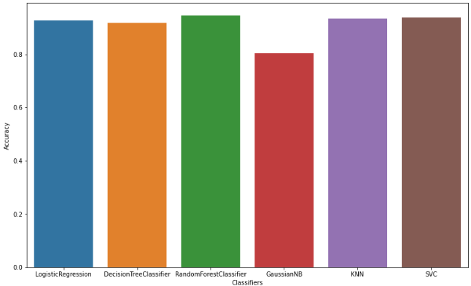
Word2Vec :
CLASSIFIERS | ACCURACY
Logistic Regression | 0.926875
Decision Tree Classifier | 0.917452
Random Forest Classifier | 0.946010
Gaussian Naïve Bayes | 0.804375
KNN (n=7) | 0.933221
SVC (linear kernel) | 0.938558
All 20800 documents are represented as a vector of size 100.
The top 2 models in terms of accuracy are Random Forest and SVC.
Further from 5x2 cv paired t test we get that, (p-value = 0.171)
since we cannot reject the null hypothesis, thus we can conclude that the performance of the
two models is probably same.

Slide 11
Overall Comparison among the best models:
S.No. | VECTORIZATION TECHNIQUE | CLASSIFICATION ALGORITHM | ACCURACY
1 | Bag of Words | Decision Tree & SVC (Linear kernel) | 99.538 & 99.49 %
2 | Bag of words + Chi Square Test | SVC (Linear kernel) | 99.50 %
3 | TF-IDF | Random Forest & Decision Tree | 99.375 & 99.365 %
4 | TF-IDF + Chi Square Test | Random Forest | 99.336 %
5 | Word2Vec | Random Forest & SVC (Linear kernel) | 94.60 & 93.85 %

Slide 12
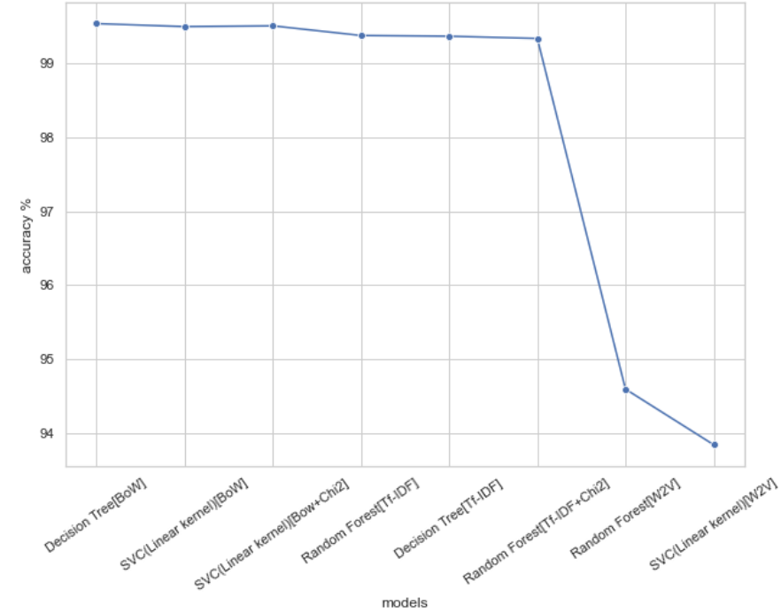

Slide 13
Conclusion:
The result of the above approaches showed that bag of words vectorization technique with Decision Tree or SVC (Linear kernel) showed the highest accuracy.
But since Bag of words vectorization with features selection using chi-square test with SVC (Linear kernel) classifier also has almost the same accuracy ,hence considering the benefits of feature reduction this approach comes out to be the better one for text classification on this data set.

Slide 14
Thank You!

